Slide 1
DUAL STEGANOGRAPHY
Hiding the text in the video by linked list
JYOTHIKA UDUGULA

Slide 2
INTRODUTION
Steganography is the science of invisible communication which hides any private data within an innocent-looking cover object. The word Steganography is derived from the Greek words “stegos” meaning “cover” and “grafia” meaning “writing” defining it as “covered writing”.

Slide 3
Modules:
Steganography method based on a module substitution is proposed.
Steganography include an input image , secret information and data hiding .
In steganography has mainly two different modules
1. Sender
2.Receiver

Slide 4
PROPOSED & EXISTING
PROPOSED SYSTEM:
In proposed system the data is embedded inside the video by embedding each byte of information iside the pixel of video frames without affecting the original quality of the video.
Large amount of data can be stored because of embedding the information inside video.
More security will be provided .
Quality of cover video will not be affected.
Since Linked List method has been used for embedding information inside video, it will be difficult for the intruders to predict the location of the presence of the information inside each frame.
Operating System :Windows95/98/2000/XP
Front End : java, jdk1.6
Database : My sqlserver 2005
Database Connectivity : JDBC.

Slide 5
EXISTING SYSTEM:
Video Steganography may be a technique to cover any reasonably files into a carrying video file.
The employment of the video primarily based steganography is additional eligible than different transmission files thanks to its size and memory necessities. Videos square measure the set of pictures.
Processor - Pentium –III
Speed - 1.1 Ghz
RAM - 256 MB(min)
Hard Disk - 20 GB
Floppy Drive - 1.44 MB
Key Board - Standard Windows Keyboard
Mouse - Two or Three Button Mouse
Monitor - SVGA

Slide 6
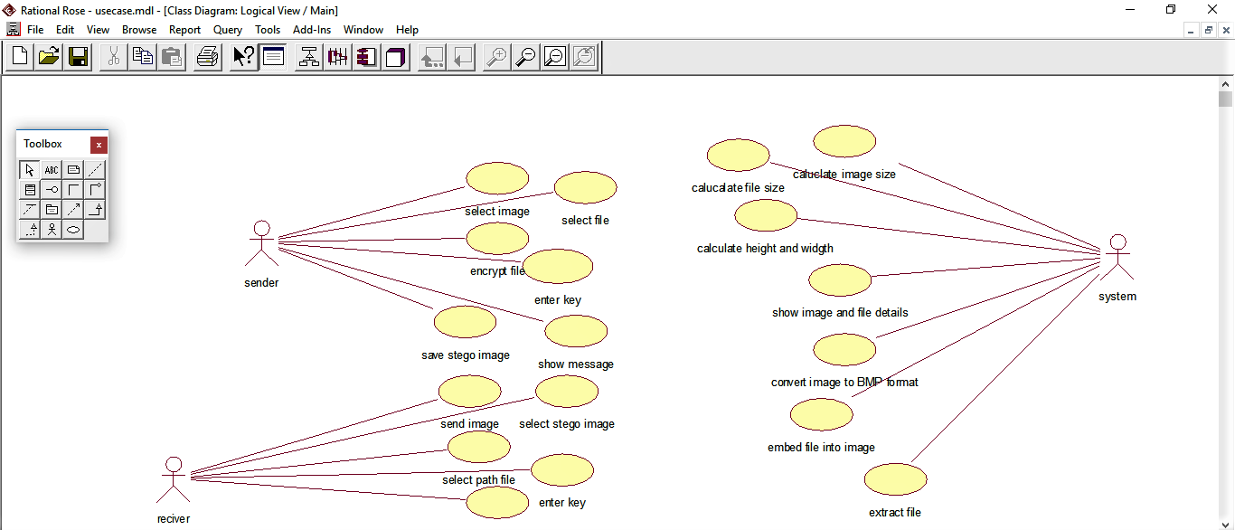
UML DIAGRAMS
Use Case:

Slide 7
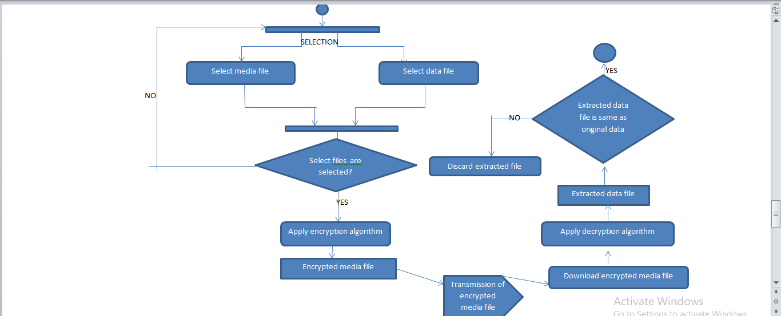
Flow Chart:

Slide 8
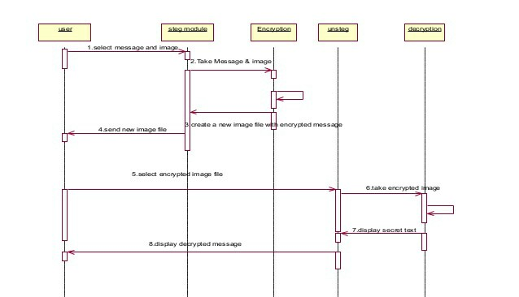
_{Sequence:}

Slide 9
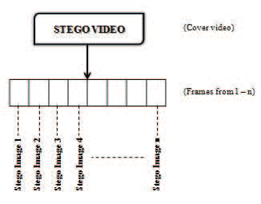
IMPLEMENTATION:
Stegnography with Video is a desktop application. The purpose of this application is to provide the security for the confidential information.
This application doesn’t allow the hackers to view the data, can view only video file when it is being passed over the internet

Slide 10
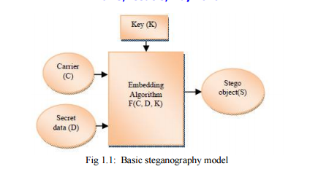
The basic model consists of Carrier(C), Secret Data(D), Stego Key(K).
1. Carrier is the cover object in which the message is embedded.
2. Secret data can be any type of confidential data that can be plain text, cipher text or other image.
3. Key mainly used to ensure that only recipient having the decoding key will be able to extract the message from a cover-object.
4. By using the embedding algorithm, the secret data is embedded into the cover object in a way that does not change the original image in a human perceptible way.

Slide 11
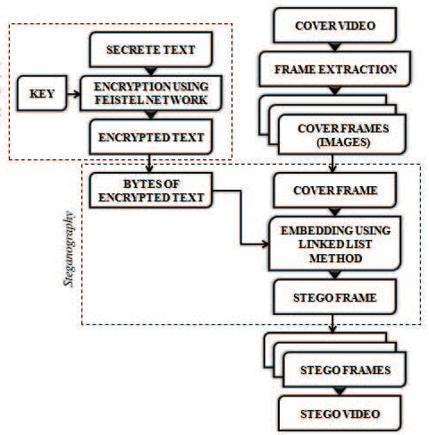
EncryptED ARCHITECTURE: Extracting frames from video Encrypting data using Feistel network algorithm Embedding text inside image frame

Slide 12
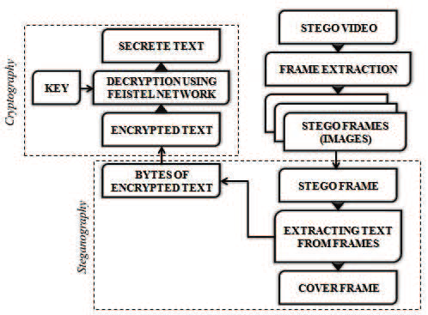
DECRYPTED ARCHITETURE: Extracting frames from Stego video Separating data from stego frames

Slide 13
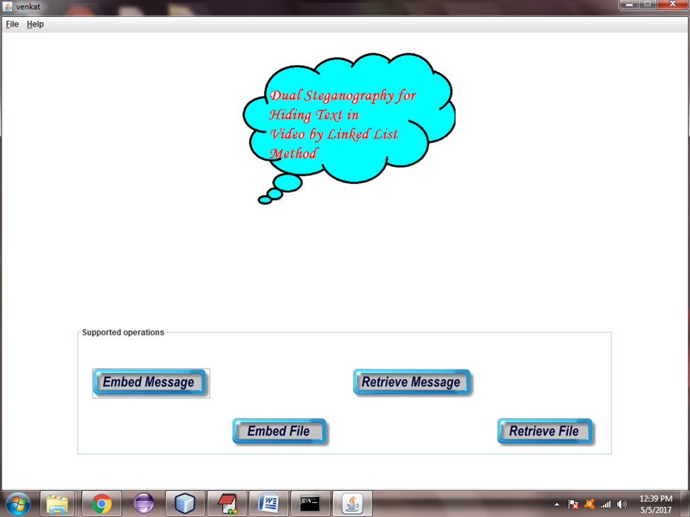
Home page

Slide 14
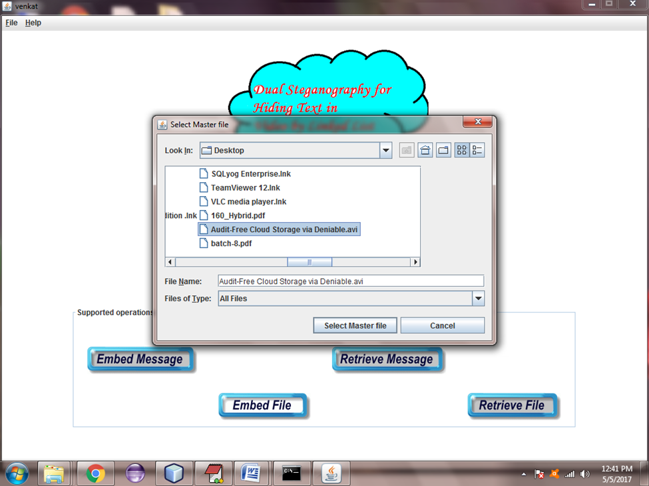
Embedding file:selecting masters video file

Slide 15
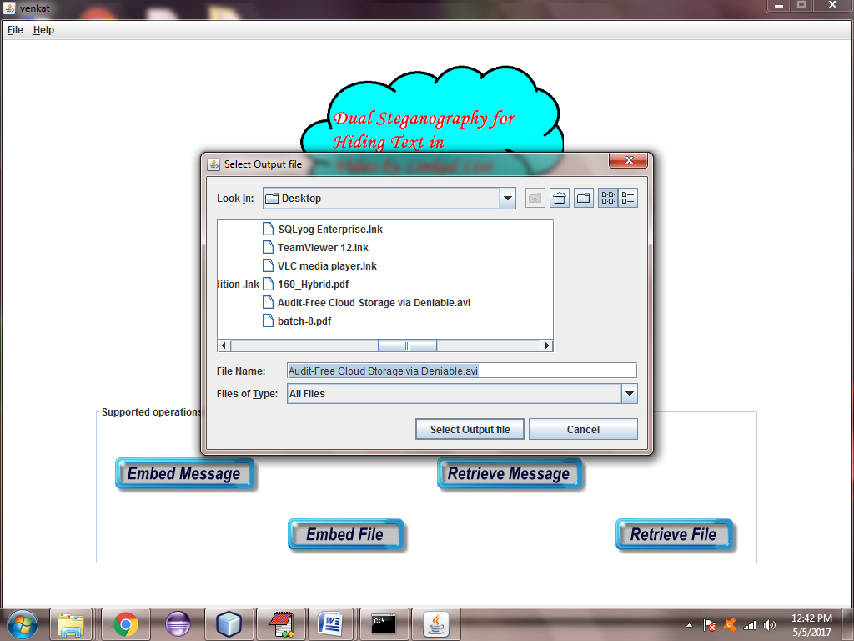
Embedding file:selecting output video file

Slide 16

Selecting data file:

Slide 17
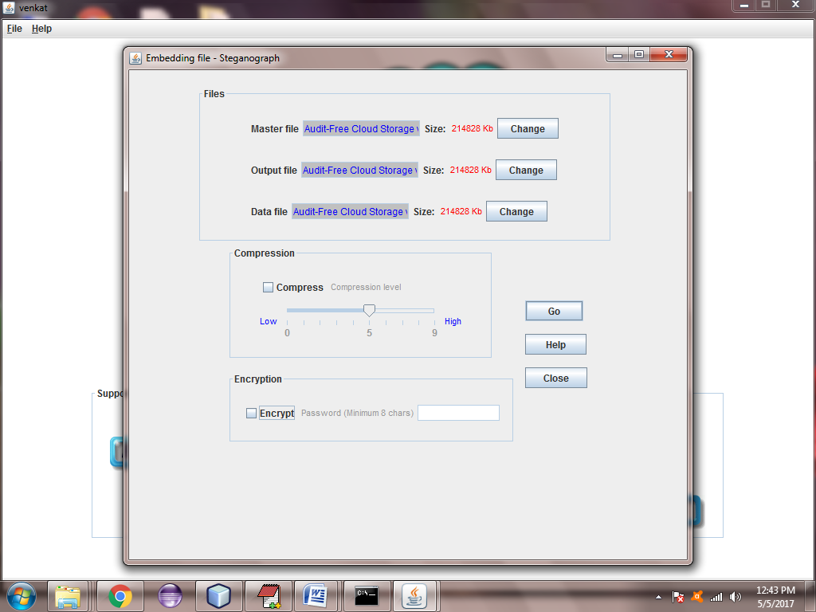
Embedding file :

Slide 18
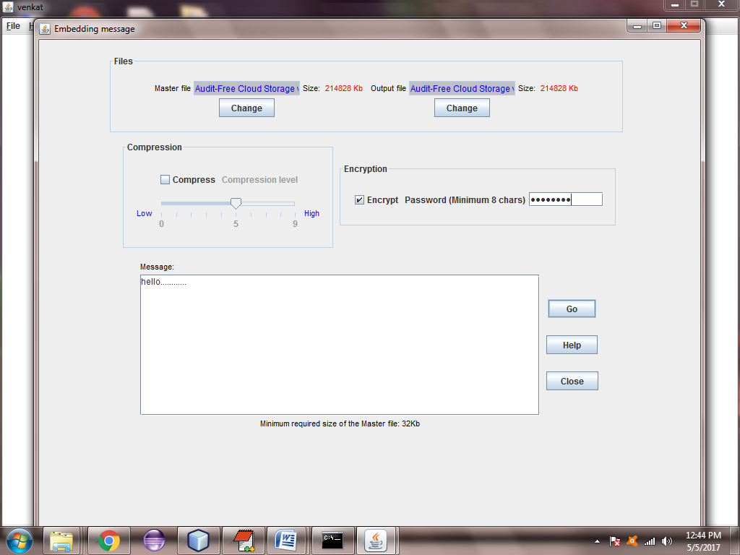
Embedding message by giving password :

Slide 19
TESTING
Testing is the process of trying to discover every conceivable fault or weakness in a work product. It provides a way to check the functionality of components, sub assemblies, assemblies and/or a finished product It is the process of exercising software with the intent of ensuring that the
Software system meets its requirements and user expectations and does not fail in an unacceptable manner. There are various types of test. Each test type addresses a specific testing requirement.

Slide 20
CONCLUSION
The Linked List method and Feistel Network has been introduced for hiding Information inside Video.
The two main algorithms used for data encryption and data embedding are Feistel Network and Linked List method respectively.
Then the encryption of data takes place using Feistel Network. After encryption of data, the encrypted data is embedded inside each video frames using Linked List method and Stego frames are produced.
Later, the Stego Frames are combined to get a Stego Video.
This technique provides a high level security to the information and the quality of stego video will be equal to the cover video.

Slide 21
THANK YOU

